Slide 1
Workshop Dynamical Aspects of Automata and Semigroup Theories,
25-26 November 2010, Wien, Austria
Synchronizing Words and
Carefully Synchronizing Words
Pavel Martyugin
Ural State University, Ekaterinburg, Russia

Slide 2
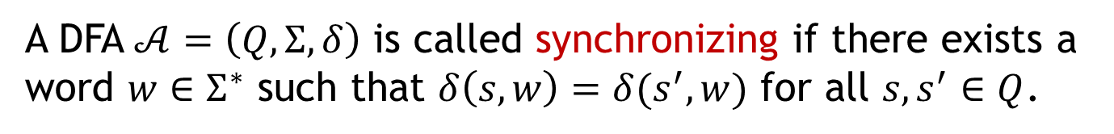
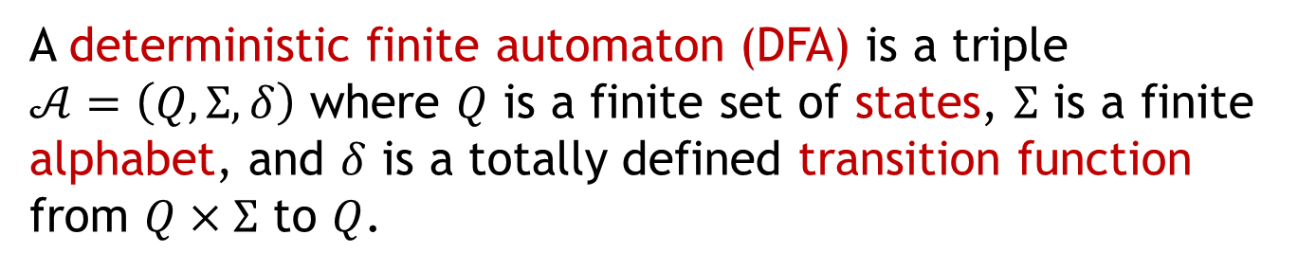
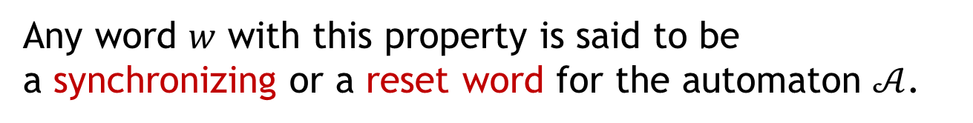
Synchronizing automata
A deterministic finite automaton (DFA) is a triple $𝒜=\left(Q,Σ,δ\right)$ where $Q$ is a finite set of states, $Σ$ is a finite alphabet, and $δ$ is a totally defined transition function from $Q×Σ$ to $Q$.
A DFA $𝒜=\left(Q,Σ,δ\right)$ is called synchronizing if there exists a word $w∈Σ^{∗}$ such that $δ\left(s,w\right)=δ(s^{′},w)$ for all $s,s^{′}∈Q$.
Any word $w$ with this property is said to be
a synchronizing or a reset word for the automaton $𝒜$.

Slide 3
Synchronizing automata
The example of a synchronizing DFA with 4 states and 2 letters.
b
a,
b
4
1
a
a
3
2
a
b
b
$baaabaaab$ is the shortest synchronizing word of length $9$.

Slide 4











Synchronizing automata
$$b$$
$$b$$
$$a$$
$$b$$
$$a$$
$$b$$
$$a$$
$$a$$
$$a$$
$$b$$
$$b$$

Slide 5

















Synchronizing automata
$$b$$
$$a$$
$$b$$
$$a$$
$$a$$
$$a$$
$$b$$
$$b$$
$$b$$
$$a$$
$$a$$
$$a$$
$$b$$
$$a$$
$$a$$
$$a$$
$$b$$

Slide 6
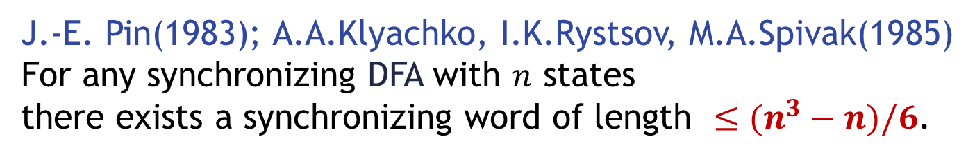
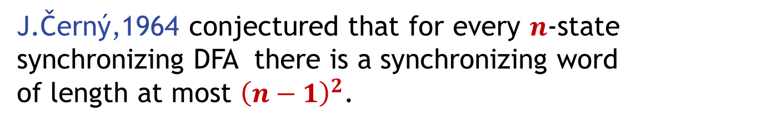
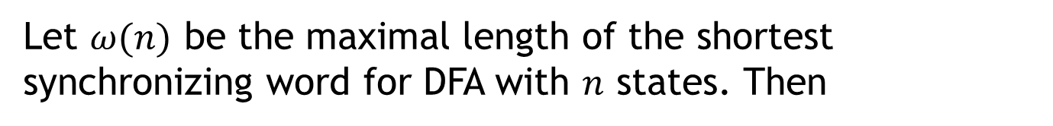
Černý conjecture
J.Černý,1964 conjectured that for every $n$-state synchronizing DFA there is a synchronizing word
of length at most ${\left(n−1\right)}^{2}$.
This conjecture is unproved.
J.-E. Pin(1983); A.A.Klyachko, I.K.Rystsov, M.A.Spivak(1985)
For any synchronizing DFA with $n$ states
there exists a synchronizing word of length $≤(n^{3}−n)/6$.
Let $ω(n)$ be the maximal length of the shortest synchronizing word for DFA with $n$ states. Then
$${\left(n−1\right)}^{2}≤ω\left(n\right)≤(n^{3}−n)/6$$

Slide 7
Computational problems
Computation problems:
Is a given DFA synchronizing or not?
What is the length of the shortest synchronizing word for a given DFA?

Slide 8
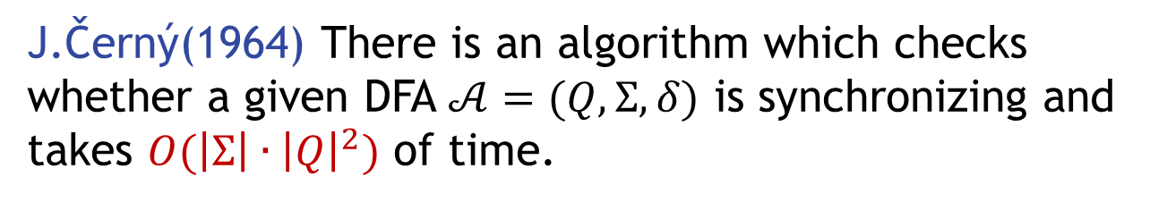
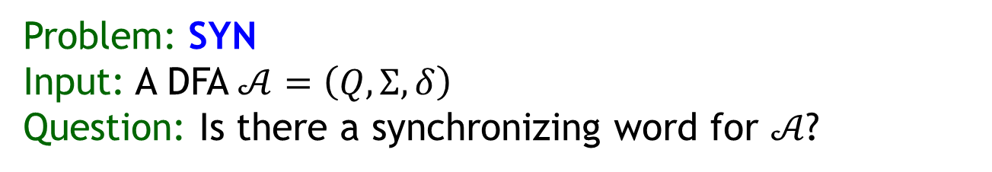
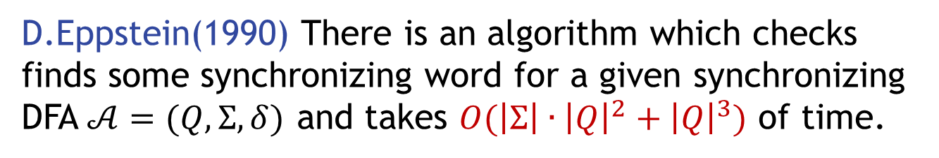
Computational problems
Problem: SYN
Input: A DFA $𝒜=\left(Q,Σ,δ\right)$
Question: Is there a synchronizing word for $𝒜$?
J.Černý(1964) There is an algorithm which checks whether a given DFA $𝒜=(Q,Σ,δ)$ is synchronizing and takes $O({\left|Σ\right|∙\left|Q\right|}^{2})$ of time.
D.Eppstein(1990) There is an algorithm which checks finds some synchronizing word for a given synchronizing DFA $𝒜=(Q,Σ,δ)$ and takes $O({\left|Σ\right|∙\left|Q\right|}^{2}+{\left|Q\right|}^{3})$ of time.

Slide 9
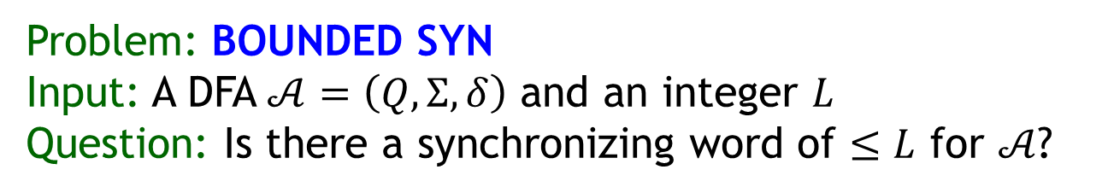
Computational problems
Problem: BOUNDED SYN
Input: A DFA $𝒜=\left(Q,Σ,δ\right)$ and an integer $L$
Question: Is there a synchronizing word of $≤L$ for $𝒜$?
D.Eppstein(1990) The problem BOUNDED SYN
is NP-complete.
This problem remains NP-complete for automata over a 2-letter alphabet.

Slide 10
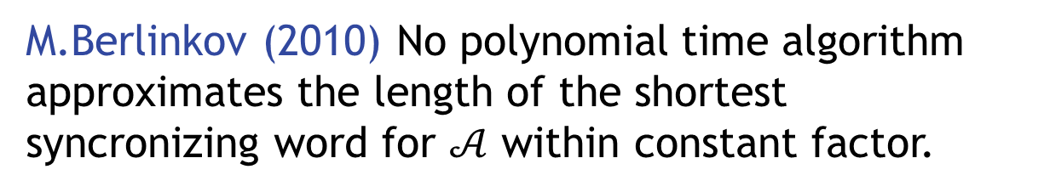
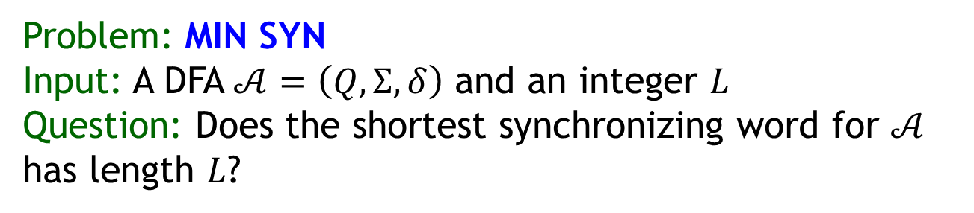
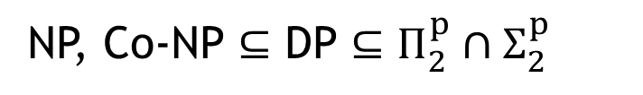
Computational problems
Problem: MIN SYN
Input: A DFA $𝒜=\left(Q,Σ,δ\right)$ and an integer $L$
Question: Does the shortest synchronizing word for $𝒜$ has length $L$?
J.Olschewski, M.Ummels (2010) The problem MIN SYN
is complete for the complexity class DP
NP, Co-NP $⊆$ DP $⊆Π_{2}^{p}∩Σ_{2}^{p}$
M.Berlinkov (2010) No polynomial time algorithm approximates the length of the shortest syncronizing word for $𝒜$ within constant factor.

Slide 11
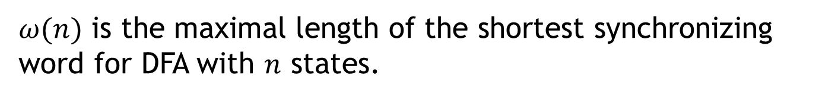
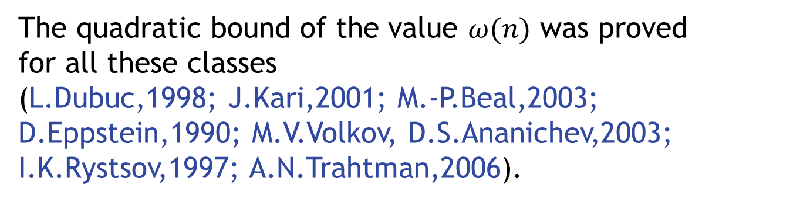
Subclasses of DFA
The Černý’s problem and the complexities problems can be considered for some special cases of DFA.
We consider here classes of cyclical, Eulerian, monotonic, cyclically monotonic, commutative DFA and DFA with a zero state.
$ω(n)$ is the maximal length of the shortest synchronizing word for DFA with $n$ states.
The quadratic bound of the value $ω(n)$ was proved
for all these classes
(L.Dubuc,1998; J.Kari,2001; M.-P.Beal,2003;
D.Eppstein,1990; M.V.Volkov, D.S.Ananichev,2003; I.K.Rystsov,1997; A.N.Trahtman,2006).

Slide 12

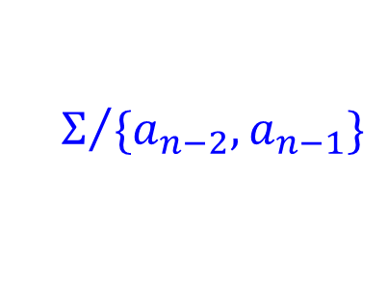
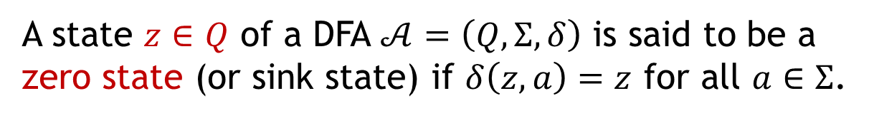

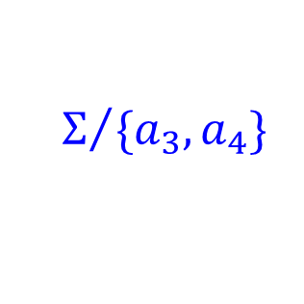




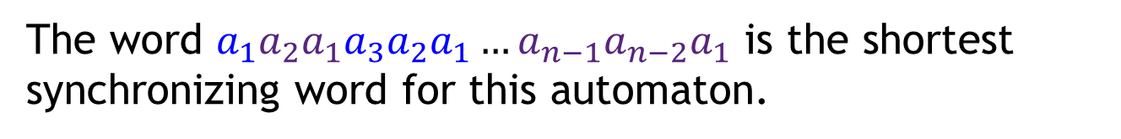
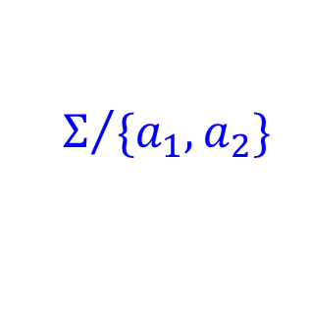
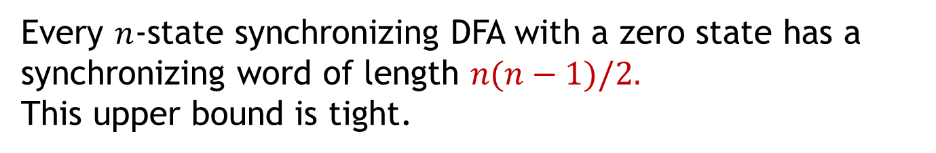


DFA with a zero state
A state $z∈Q$ of a DFA $𝒜=\left(Q,Σ,δ\right)$ is said to be a
zero state (or sink state) if $δ\left(z,a\right)=z$ for all $a∈Σ$.
0
$$Σ$$
Every $n$-state synchronizing DFA with a zero state has a synchronizing word of length $n(n−1)/2.$
This upper bound is tight.
$$Σ$$
$$Σ/{\{a_{1},a_{2}\}}$$
$$Σ/{\{a_{2},a_{3}\}}$$
$$Σ/{\{a_{3},a_{4}\}}$$
$$Σ/{\{a_{n−2},a_{n−1}\}}$$
$$Σ/{\{a_{n−1}\}}$$
$$a_{1}$$
$$a_{2}$$
$$a_{3}$$
$$a_{n−1}$$
0
1
2
3
n-2
n-1
The word $a_{1}a_{2}a_{1}a_{3}a_{2}a_{1}…a_{n−1}a_{n−2}a_{1}$ is the shortest synchronizing word for this automaton.

Slide 13
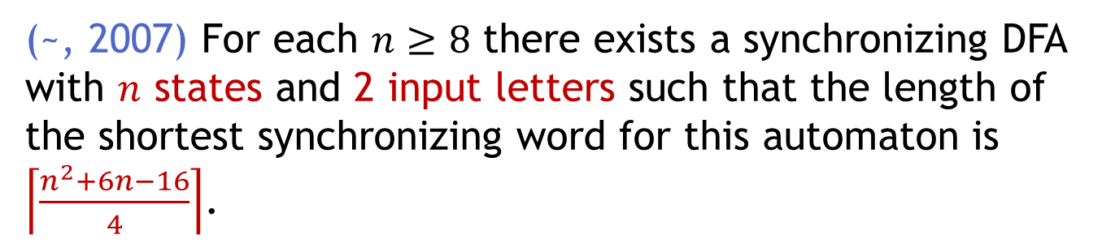
DFA with a zero state
In the previous example the input alphabet size grows with number of states, while in the Černý example the alphabet has two elements for every number of states.
(~, 2007) For each $n≥8$ there exists a synchronizing DFA with $n$ states and 2 input letters such that the length of the shortest synchronizing word for this automaton is $\left\lceil \frac{n^{2}+6n−16}{4}\right\rceil$.
0

Slide 14



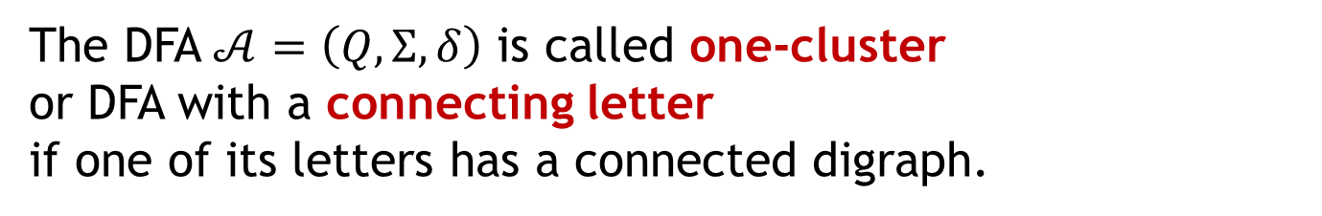
Cyclical DFA
The DFA $𝒜=\left(Q,Σ,δ\right)$ is called cyclical if it contains
a letter which acts as a cycle of length $|Q|$.
The DFA $𝒜=\left(Q,Σ,δ\right)$ is called one-cluster
or DFA with a connecting letter
if one of its letters has a connected digraph.
L.Dubuc (1998) For the class of cyclical DFA
$$ω\left(n\right)={\left(n−1\right)}^{2}$$
M.-P. Beal, D. Perrin(2009), M.V. Berlinkov (2010)
For the class of one-cluster DFA
$${\left(n−1\right)}^{2}≤ω\left(n\right)≤2n^{2}−7n+7$$
~ (2008) The problem BOUNDED SYN is NP-complete
for cyclical and one-cluster DFA

Slide 15
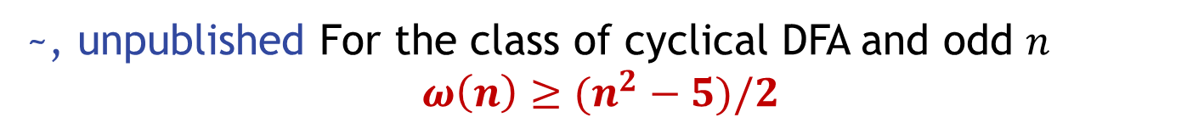
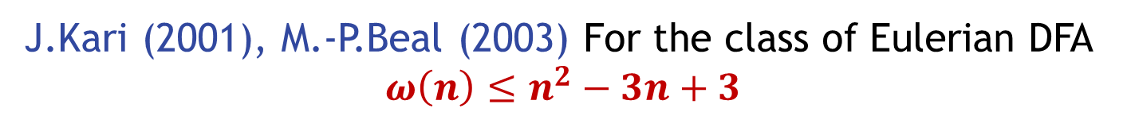
Eulerian DFA
The DFA is called Eulerian if its digraph is Eulerian.
J.Kari (2001), M.-P.Beal (2003) For the class of Eulerian DFA
$$ω\left(n\right)≤n^{2}−3n+3$$
~, unpublished For the class of cyclical DFA and odd $n$
$$ω\left(n\right)≥(n^{2}−5)/2$$
~ (2008) The problem BOUNDED SYN is NP-complete
for Eulerian DFA

Slide 16
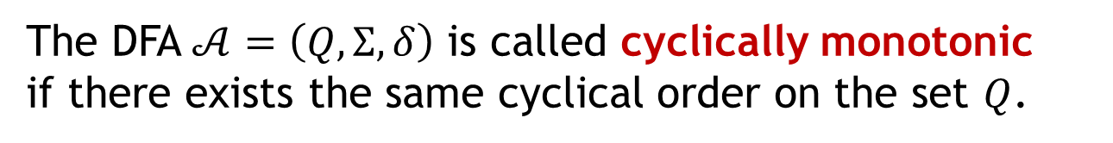
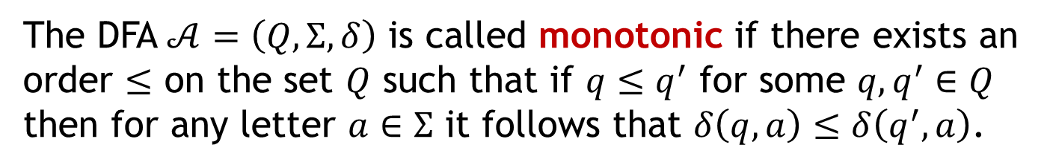
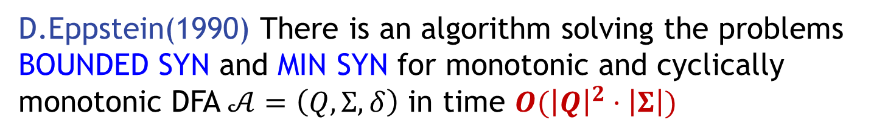
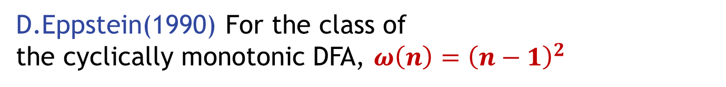
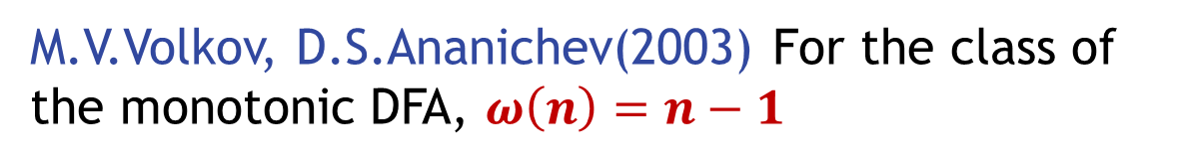
Monotonic DFA
The DFA $𝒜=\left(Q,Σ,δ\right)$ is called monotonic if there exists an order $≤$ on the set $Q$ such that if $q≤q^{′}$ for some $q,q^{′}∈Q$ then for any letter $a∈Σ$ it follows that $δ\left(q,a\right)≤δ\left(q^{′},a\right)$.
The DFA $𝒜=\left(Q,Σ,δ\right)$ is called cyclically monotonic
if there exists the same cyclical order on the set $Q$.
M.V.Volkov, D.S.Ananichev(2003) For the class of
the monotonic DFA, $ω\left(n\right)=n−1$
D.Eppstein(1990) For the class of
the cyclically monotonic DFA, $ω\left(n\right)={\left(n−1\right)}^{2}$
D.Eppstein(1990) There is an algorithm solving the problems
BOUNDED SYN and MIN SYN for monotonic and cyclically monotonic DFA $𝒜=\left(Q,Σ,δ\right)$ in time $O({\left|Q\right|}^{2}⋅\left|Σ\right|)$

Slide 17
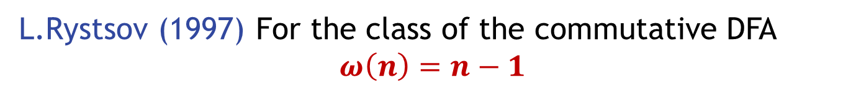

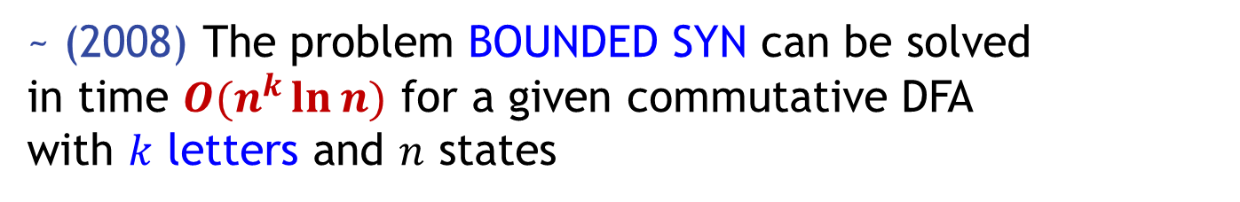
Commutative DFA
The DFA $𝒜=\left(Q,Σ,δ\right)$ is called commutative
if for all $a,b∈Σ, q∈Q$it follows $δ\left(q,ab\right)=δ(q,ba)$.
L.Rystsov (1997) For the class of the commutative DFA
$$ω\left(n\right)=n−1$$
~ (2008) The problem BOUNDED SYN is NP-complete
for the class of all commutative DFA
~ (2008) The problem BOUNDED SYN can be solved
in time $O(n^{k}\ln{n})$ for a given commutative DFA
with $k$ letters and $n$ states

Slide 18
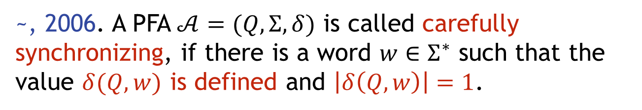
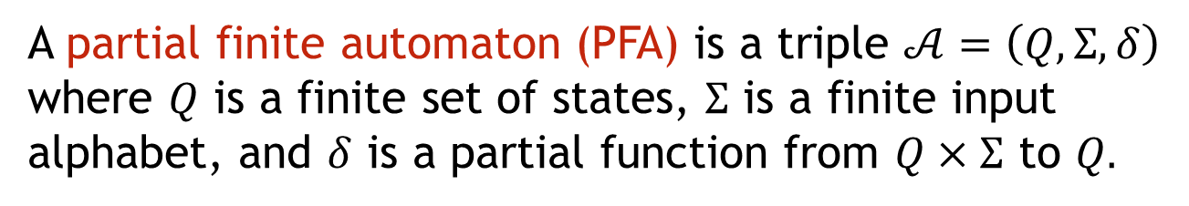
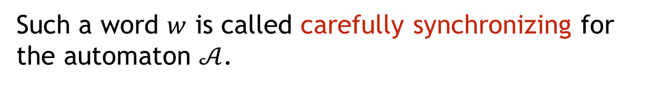
Careful synchronization
A partial finite automaton (PFA) is a triple $𝒜=\left(Q,Σ,δ\right)$ where $Q$ is a finite set of states, $Σ$ is a finite input alphabet, and $δ$ is a partial function from $Q×Σ$ to $Q.$
~, 2006. A PFA $𝒜=(Q,Σ,δ)$ is called carefully synchronizing, if there is a word $w∈Σ^{∗}$ such that the value $δ(Q,w)$ is defined and $\left|δ\left(Q,w\right)\right|=1$.
Such a word $w$ is called carefully synchronizing for the automaton $𝒜$.
If the PFA is a DFA then
careful synchronization = synchronization

Slide 19
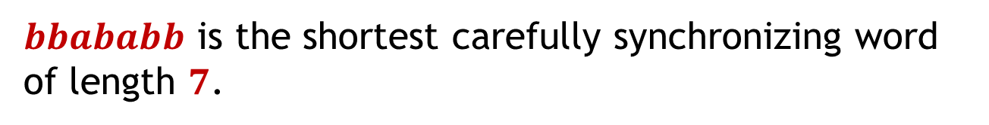
Careful synchronization
The example of a carefully synchronizing PFA with 4 states and 2 letters.
b
a,
b
4
1
b
a
3
2
a
b
$bbababb$ is the shortest carefully synchronizing word of length $7$.

Slide 20




Careful synchronization
$$b$$
$$a$$
$$a$$
$$b$$
$$b$$
$$a$$
$$b$$
$$b$$
$$a$$
$$a$$
$$b$$

Slide 21














Careful synchronization
$$b$$
$$a$$
$$b$$
$$b$$
$$a$$
$$a$$
$$b$$
$$b$$
$$b$$
$$a$$
$$b$$
$$a$$
$$b$$
$$b$$

Slide 22
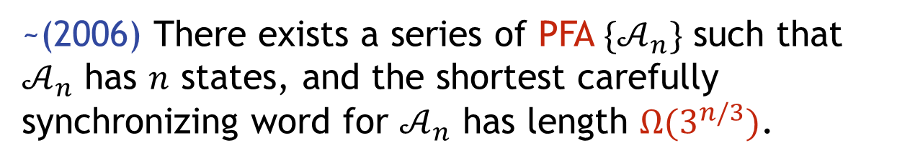
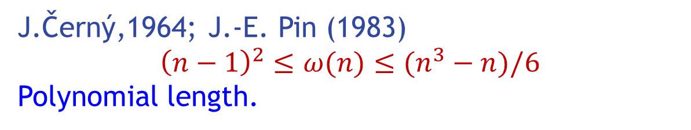

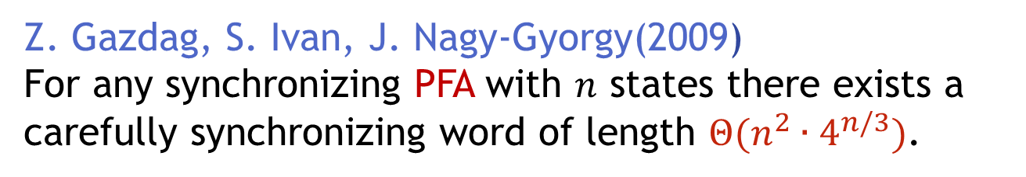
Exponential length
J.Černý,1964; J.-E. Pin (1983)
$${\left(n−1\right)}^{2}≤ω(n)≤(n^{3}−n)/6$$
Polynomial length.
~(2006) There exists a series of PFA ${\{𝒜}_{n}\}$ such that
$𝒜_{n}$ has $n$ states, and the shortest carefully synchronizing word for $𝒜_{n}$ has length $Ω(3^{n/3})$.
Z. Gazdag, S. Ivan, J. Nagy-Gyorgy(2009)
For any synchronizing PFA with $n$ states there exists a carefully synchronizing word of length $Θ(n^{2}∙4^{n/3})$.
$$Ω(3^{n/3})≤ω_{car}(n)≤Θ(n^{2}∙4^{n/3})$$
Exponential length.

Slide 23



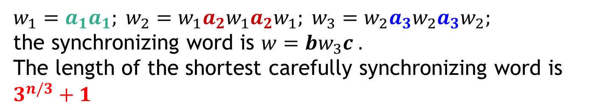




Exponential length
0
$$a_{2}$$
$$a_{3}$$
$$a_{1}$$
$$b$$
$$b$$
$$b$$
1
2
$$c$$
$$w_{1}=a_{1}a_{1}; w_{2}=w_{1}a_{2}w_{1}a_{2}w_{1}; w_{3}=w_{2}a_{3}w_{2}a_{3}w_{2};$$
the synchronizing word is $w=bw_{3}c .$
The length of the shortest carefully synchronizing word is $3^{n/3}+1$

Slide 24
3 Letters
The lengths of cycles are consecutive prime numbers
The shortest carefully synchronizing word has nonpolynomial length.

Slide 25
2 Letters
The lengths of blocks are consecutive prime numbers
The shortest carefully synchronizing word has nonpolynomial length.

Slide 26
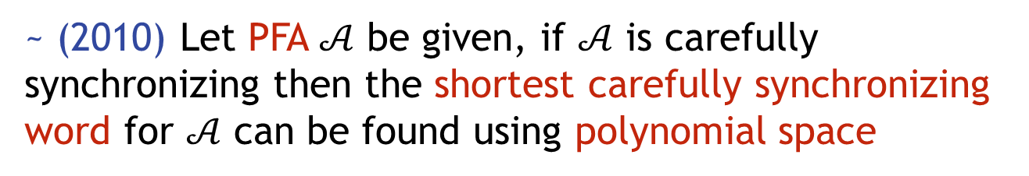
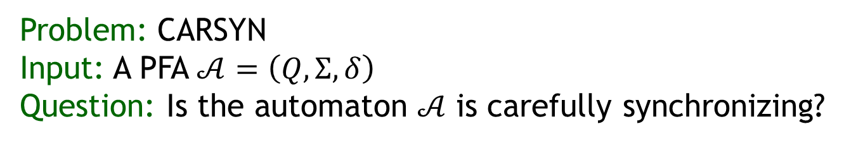
Computational problems
Problem: CARSYN
Input: A PFA $𝒜=\left(Q,Σ,δ\right)$
Question: Is the automaton $𝒜$ is carefully synchronizing?
~ (2010)
The problem CARSIN is PSPACE-complete
The problem CARSIN remain PSPACE-complete for automata with 2-letter alphabet
~ (2010) Let PFA $𝒜$ be given, if $𝒜$ is carefully synchronizing then the shortest carefully synchronizing word for $𝒜$ can be found using polynomial space

Slide 27
Thank you!

