Slide 1
From MDE (model driven engineering) to CT and back
Zinovy Diskin

Slide 2
My experience
….. Algebraic logic
1993-97 --- Database design for a private company in Latvia
98-2004 –- Business analyst in US
05-present --- Several academia/industry projects on MDE in Canada (funded 50/50)

Slide 3
CT for SE, why?
CT’s applications for Physics, Comp. Science, Linguistics… are well known, so what?
Size
Quality

Slide 4
Modeling of modeling
World
modeling
Model
reasoning
Δ
interpretation

Slide 5
Modeling of modeling: Comp.Sci
deep abstraction
deep reasoning
World
Model
Δ
interpretation

Slide 6
Modeling of modeling: Engineering
World
shallow abstraction
shallow reasoning
Model
Δ
interpretation

Slide 8
Modeling in Science vs. in Engineering
Ordinary math structures:
few sorts, few relations, few operations
simple carrier structures but complex formulas
Difficult theorems from simple axioms
SE structures:
hundreds of sorts, rels, operations
complex carrier structures but simple formulas
Simple theorems from difficult axioms

Slide 9
Modeling of modeling: Engineering
shallow abstraction
1001 shallow reasoning
1001 shallow abstractions
World
Model
Δ
interpretation

Slide 10
Content
What MDE is
Models as generalized sketches
Towers of models: metamodeling vs. logic
Three dimensions of the model universe:
  typing, model matching, updates
Observations and speculations

Slide 11
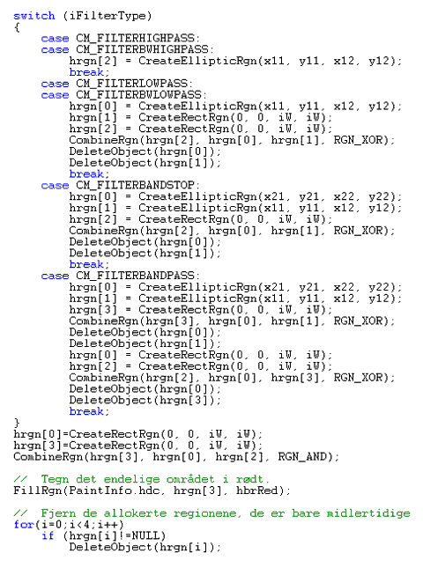
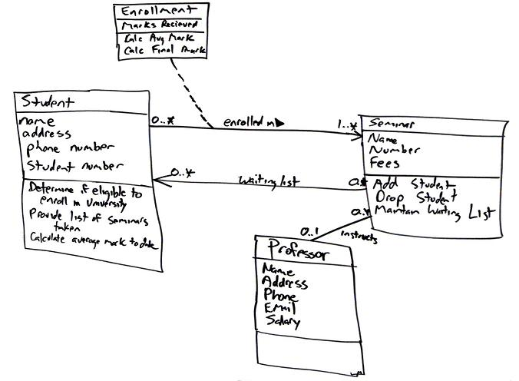
Building software with MDE
Requirements --> Analysis --> Design --> Coding
World
Models
Code

Slide 12
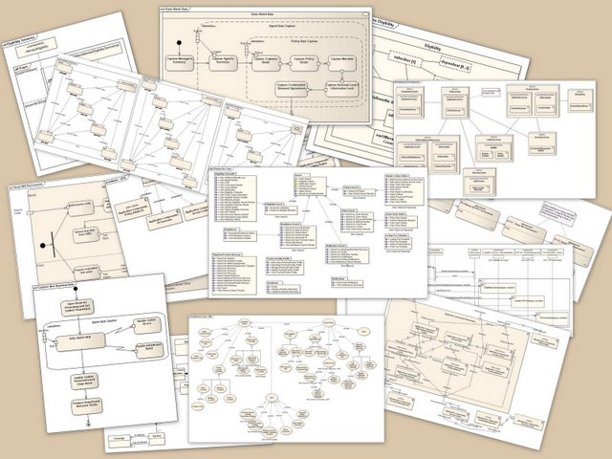
UML offers 13 types of diagrams

Slide 13
Structural problems of MDE
World
Code
Δ

Slide 14
MDE in Canada: the NECSIS project
Total budget is CAD….. for 5 years
7 Universities across Canada (McMaster, Waterloo, UofT, UBC, McGill…)
20 professors,
Funded by GM, IBM, NSERC

Slide 15
A UML class diagram and its instance
Model M
driver
drives
Person
name: string [1] tel: integer [1..3]
Car
num: string [1]
1..2
Instance I of M
1:driver
2:drives
P1: Person
name = John tel = {11,22}
C1:Car
num=100
4:drives
P2: Person
name = Mary tel = {11,33}
3:driver

Slide 16
Models as generalized sketches
Model M
driver
drives
Person
name: Str [1] tel: Int [1..3]
Car
num: Str [1]
1..2
Persons with names A* drive 2 cars
drives
2
A*-Person
Person
Car
[inverse]
driver [1..2]
tel [1..3]
name [1]
num [1]
[Int]
[Str]
[A*-Str]

Slide 17
Semantics of constraints
A gen. sketch is given by the following data:
A signature of diagram predicates
ar: Pred --> Graph (= cat. of graphs)
Given P in Pred, its semantics is
[[P]] \subset Graph(_,ar(P))
An ar-sketch is S=(G_{S}, C_{S}) with G_{S} the carrier graph and C_{S} a set of constraints
{(P,d): P in Pred, d: ar(P)--> G_{S} }
Given an “instance” I, t_{I}: G_{I} --> G_{S}, and a constraint c=(P,d) in C_{S}, we define
I|= c iff PB_{d}(t_{I}) in [[P]]

Slide 18
Metamodeling sketches
Metamod M_{ske}
P in Pred
P-diagrams
….
2
1
2
3
12
23
13
12
23
ar(P)
1
3
Nodes
Arrows
13
sketch S
t_{S}
M_{ske}
G_{S}⁺
G_{I}⁺
?
|=
M_{gra}
G_{S}
G_{I}
t_{I}

Slide 19
Logics as a model tower
Logic | Grammar | Theory | Model
Meta-modeling | Metamodel | Model | Instance
Inst.
Metamod
Person:Obj
P1:Obj
2:ref
Object
drives:ref
ref
name:attr
1:attr
C1:Obj
Car:Obj
attribute
num:attr
3:num
John:Val
Str:Val
Value
Int: Val
001:Val

Slide 20
Inter-model relationships
(Object)
(O=E)
(Entity)
MM
R
NN
(P=E)
(Emplo-yee)
(Person)
M
M_{R}
MN
N_{R}
N
(Ana)
(A=A)
(Ann)
I
I_{MN}
IJ
J_{MN}
J
I
//
J

Slide 21
Everything changes
Typing
Src-Trg
MM
//
NN
Updates
M
//
N
I
//
J
N’
M’
//
I’
//
J’

Slide 22
Observations/Speculations
“shallow modeling” needs special structuring mechanisms (SSMs): classification, nesting, AND-OR operations
Inter-model relationships are complex structures that needs SSMs too: comma cats, profunctors, …
It is easier to talk to a software engineer than to a computer scientist

Slide 23
Typing
r
A
B
Src-Trg
t_{A}
u
1:fPpg
v
t_{B}
Updates
2:Mgr
r
A
B
r: r
2:Mgr
S
B
a
3:fPpg
b
r':r
A
B

Slide 25
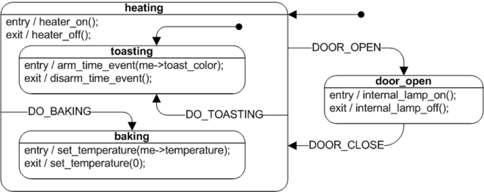
UML state machine diagrams

Slide 26
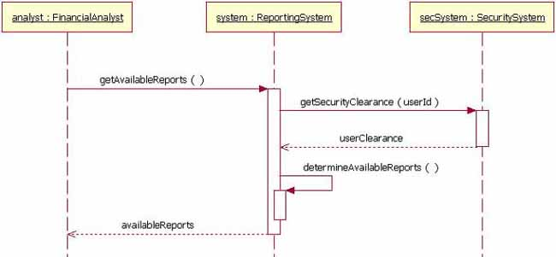
UML sequence diagrams

Slide 27
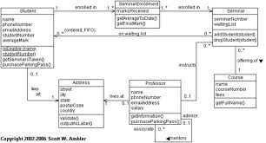
UML class diagram

